Slide 2
Awesome games with .NET, Visual Studio 2019 and Unity 2019
Jon Galloway
.NET Foundation Executive Director
@jongalloway

Slide 3
Agenda
What is Unity?
Getting Started
Why Visual Studio or Visual Studio for Mac?
Demos
What’s new in Visual Studio for Unity developers

Slide 4
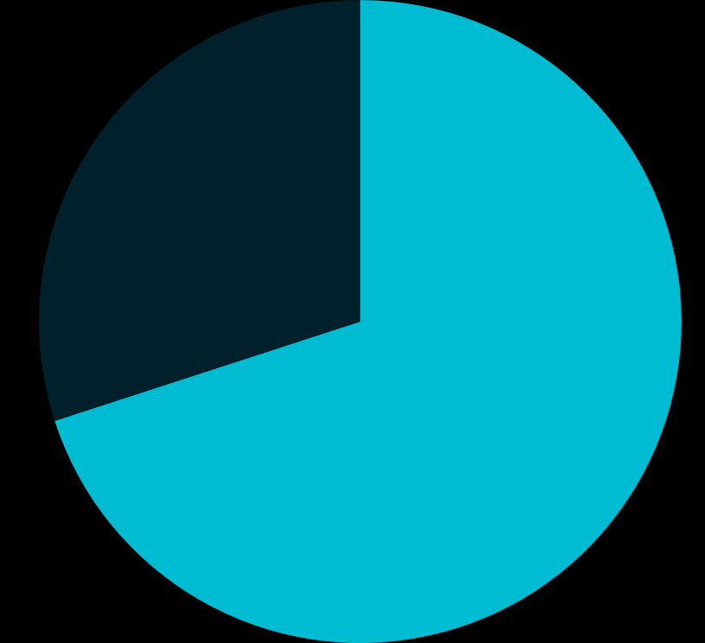
Unity
Unity is the
most widely used real-time 3D (RT3D) development platform.
Other

Slide 5





























Target and Optimize Content for 25+ Platforms
Notes:
Unity works on 25+ platforms, giving developers the power to target and optimize their content and reach the widest possible audience Including Windows, Universal Windows Platform, Mac OS, Linux, iOS, tvOS, Android (ARM & Intel X86), Android TV, FireOS, Xbox One, PlayStation 4, PlayStation Vita, Wii U, 3DS, Switch, WebGL, Gameroom (Facebook), SteamVR (PC & Mac), Oculus, PSVR, Gear VR, Cardboard (Android, iOS), Daydream, Windows Mixed Reality, HoloLens, ARKit (Apple), ARCore (Google), Vuforia and Xiaomi.

Slide 6
Getting Started
Download and install the tooling

Slide 7
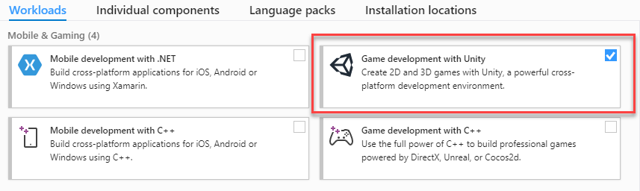
Visual Studio users
Install the .NET Game Development workload

Slide 8
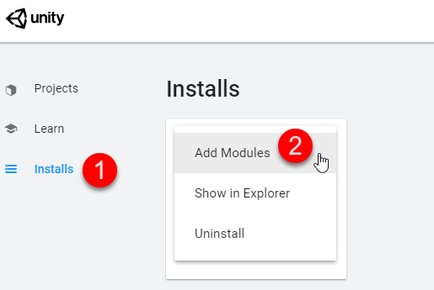
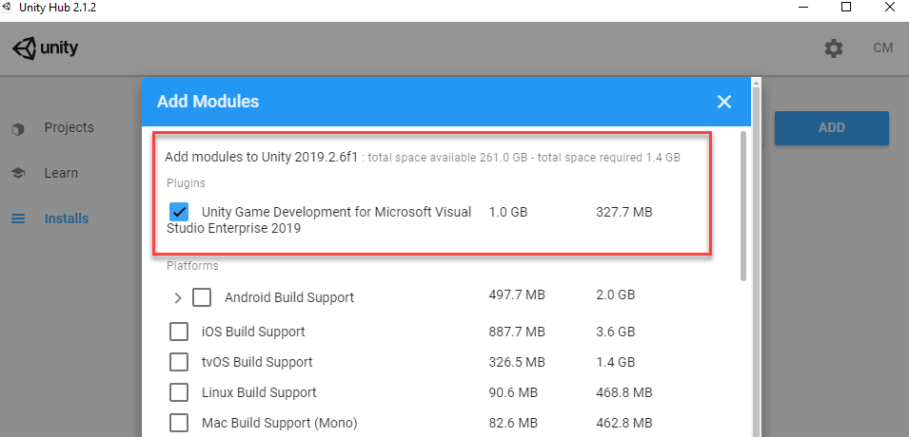
Unity users
Installation via the Unity Hub

Slide 9
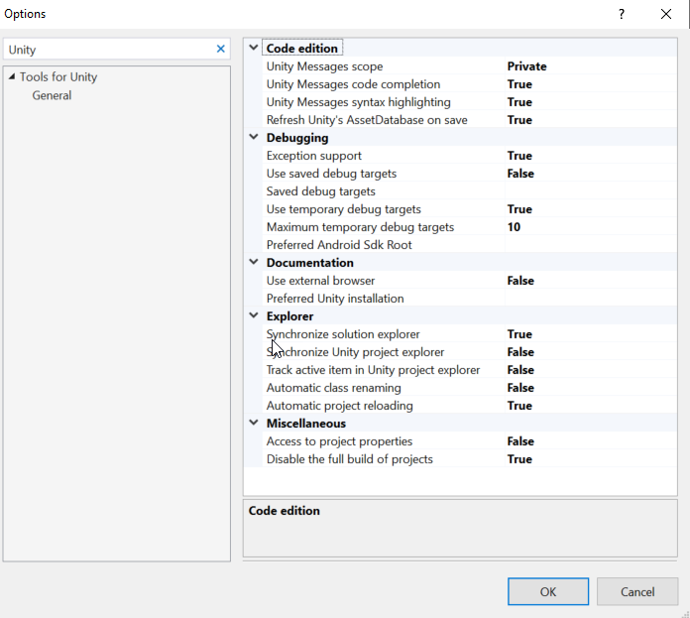
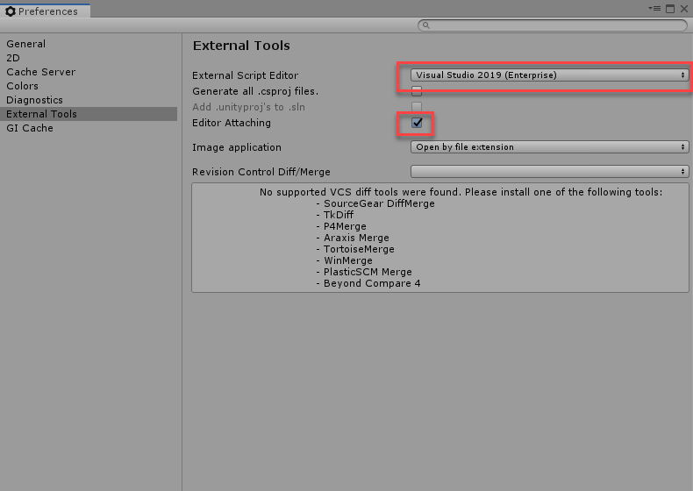
Everything’s set correctly – game on

Slide 10
Why Visual Studio or Visual Studio for Mac for game dev?

Slide 11
Visual Studio ❤ Unity
Fully featured IDE
Refactoring (Ctrl | Cmd + .)
Go to Definition (Ctrl | Cmd+ click or F12)
Navigate to decompiled assemblies
Suggested variable names
Duplicate Line (Ctrl | Cmd E+ V )
Multi-cursor mode (Ctrl + Alt | Cmd + Option + click)
Global search (Ctrl + T)
Go to Enclosing Block
Visual Studio Mac key bindings to Visual Studio on Windows 💡

Slide 12
Visual Studio ❤ Unity
Fully featured IDE
.editorConfig
CodeLens
Synchronize settings between devices
Custom screen layouts
Light and Dark themes
IntelliCode
Visual Studio Live Share
Built-in source control
Real-time code analysis

Slide 13
Demo

Slide 14
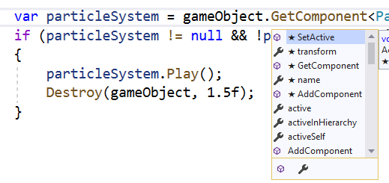
Unity and Visual Studio = 🔥
IntelliCode support for Unity API Messages
Superior Debugging
Unity Project Explorer
Attach and Play
Quickly browse Unity documentation
Notes:
For Unity projects, we’ve added a few extras in the Tools for Unity…

Slide 15
Visual Studio 16.3 + Visual Studio for Mac 8.3
Create C#, Shader, and Enum files directly in the Unity Project Explorer
Faster project reloading
Reduced attach time for debugging
Support for more unsafe code debugging options
Unity-specific analyzers and diagnostics
Suppress non-applicable C# diagnostics
Notes:
A quick look at some of the work we’ve done recently that you can take advantage of when keeping things up to date.
The latest 16.3 / 8.3 versions of VS and VSM include a subtle, but great feature of Unity-specific analyzers/diagnostics.
This comes directly from your feedback to improve refactoring options specific to Unity projects and suppress some of the generic C# diagnostics that don’t apply to Unity projects.

Slide 16
Demo

Slide 17
Next steps
Download Visual Studio or Visual Studio from Mac today
https://visualstudio.microsoft.com/download
Learning course on scripting with Unity and Visual Studio
https://aka.ms/learn-unity
Create your first game – Tic Tac Toe
https://aka.ms/first-unity-game

